Slide 1

STREAMING CATALOG SYSTEM
For real time reporting and analytics.

Slide 2
Designed and presented by:
Murtaza Badshah
Anas Nouman
Cheri Gabriel
Idowu Oyedele

Slide 3
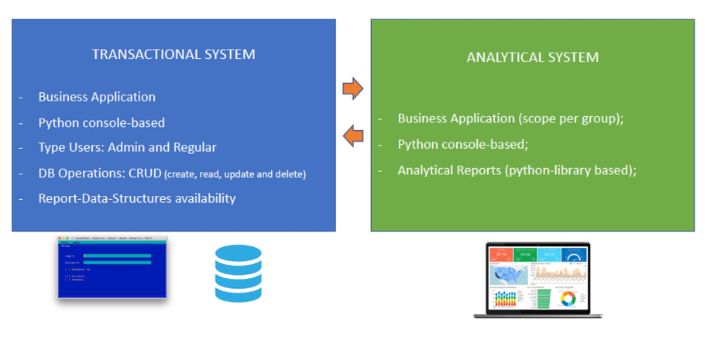
Our Task!
To built a python-based movies/series cataloging system.

Slide 4


Transactional System
Front End – Build utilizing the tkinter python framework.
Back End – Utilizing SQLite3 library.

Slide 5
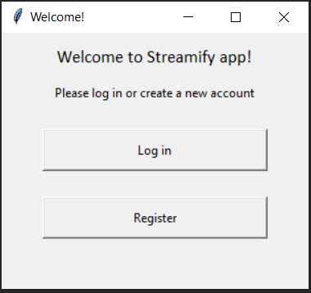
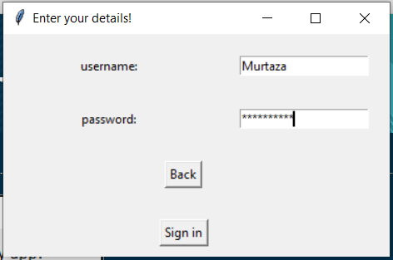
tkinter framework at play

Slide 6
Analytical System
Utilizing Jupyter Notebooks
Etc etc etc (Anas or Cherie add content here)

Slide 7
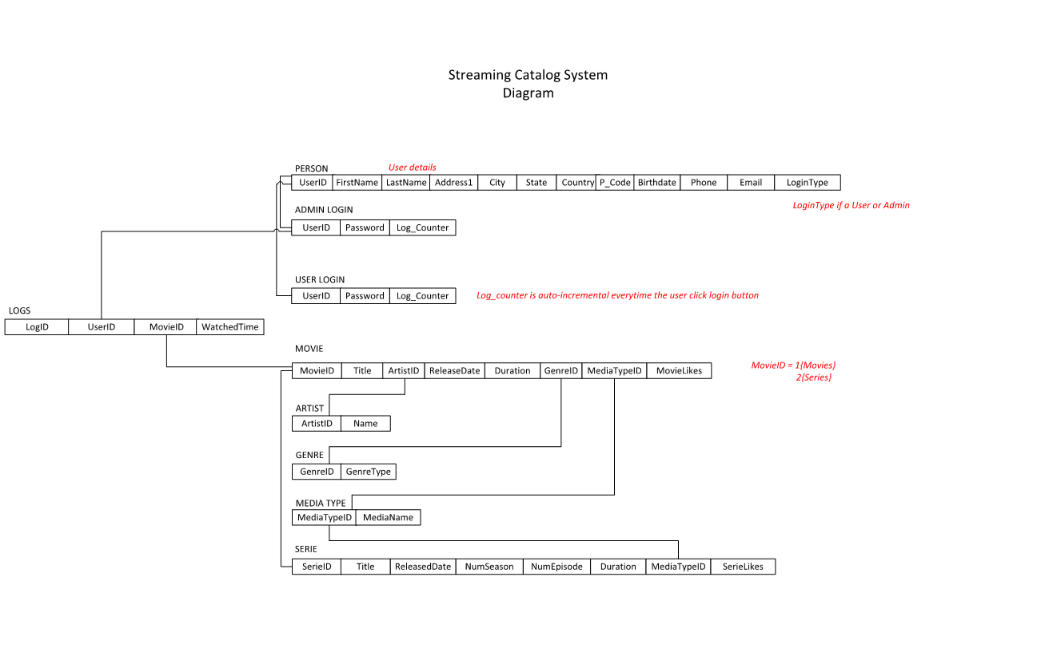
Database diagram showing the connections to the database

Slide 8


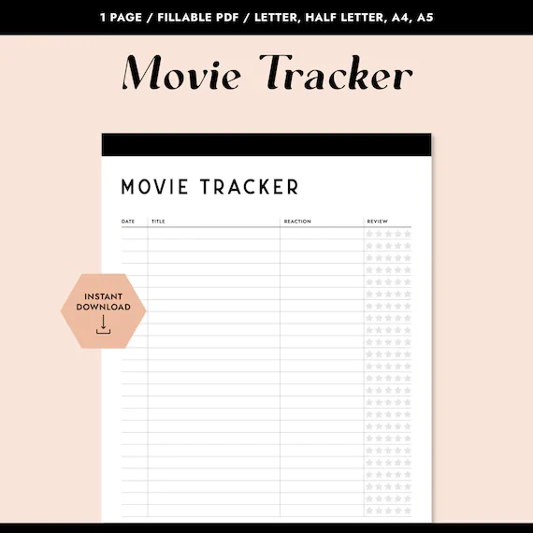
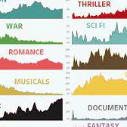
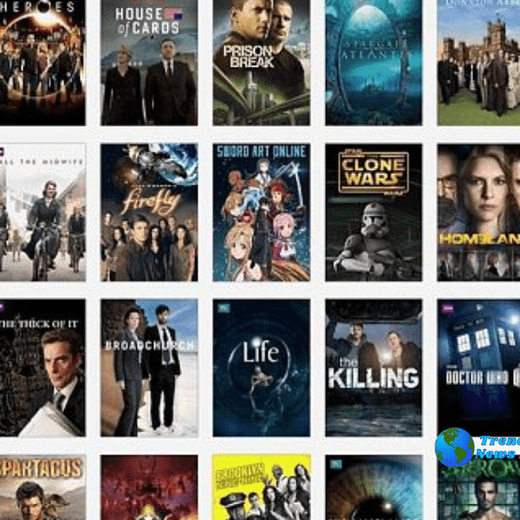
Pictorial diagram showing users access to real time movies
login:
To give users restricted access to login
Registration:
Grant privilege and access to the movie catalogue.
Movie Log/Tracker:
Display the list of movies and series available in our database.
Movie:
Displays the different genre of movies and titles. User profiles and etc.
Series:
Displays the different series, the number of episodes, number of minutes (run time) etc.

Slide 9
Thank You

